Slide 1
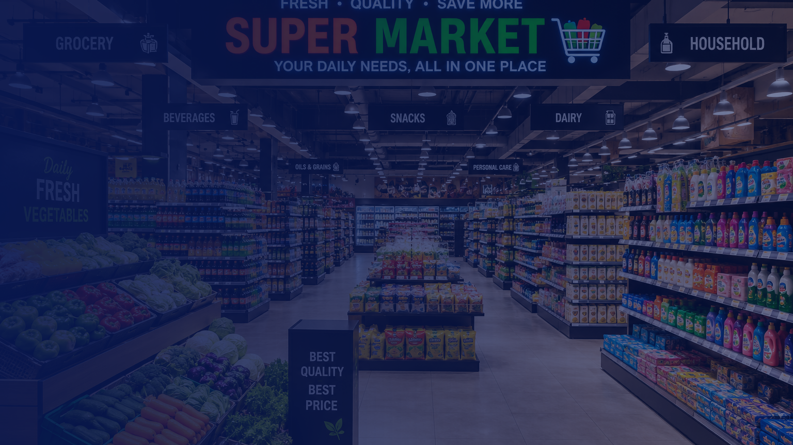


A TURNKEY GROCERY FRANCHISE OPPORTUNITY
Proven Format • Trusted Brand • Simple Economics
G R O C E R I E S
F R E S H F O O D
D A I L Y N E E D S

Slide 2

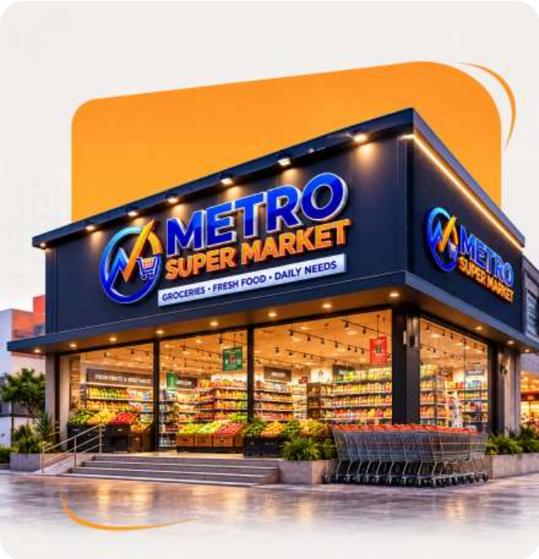


A Storefront Built To Win Customer Trust
Every Metro Super Market outlet delivers the same premium, professional first impression from the moment a customer walks up.
Bold, high-visibility branded signage
Bright, spacious entrance with a dedicated trolley bay Neatly organized fresh produce and grocery aisles
A professional look customers instantly trust
First impressions drive footfall - and footfall drives sales.

Slide 3





India's Grocery Retail Opportunity
A category too large, and too under-organized, to ignore.
$1.5 Tn+
~65%
1.3 Cr+
2X
India's retail market size, projected by 2030
Share of retail spending that goes to food & grocery
Traditional kirana stores across India
Organized retail's market share in the last decade
The shift from unorganized to organized retail is one of India's biggest business opportunities.

Slide 4
The Kirana-to-Modern-Retail Shift
India has over 1.3 crore traditional kirana stores. Most still run on unorganized shelves, manual billing, and zero brand visibility — while shoppers increasingly expect the look, speed, and trust of organized retail.
Traditional Store
Metro Super Market
Unorganized shelves & clutter
Professional store layout
Manual, error-prone billing
Digital POS billing
Limited product variety
Wide, organized product range
Zero brand visibility
Strong local brand identity
Traditional stores are losing customers to modern formats. Evolving is no longer optional.

Slide 5






Why Partner with Metro Super Market
A complete ecosystem that lets local stores compete with modern retail chains.
Modern Store Design
POS Technology
Supply Chain Network
Branding & Marketing
Community Support
Professional layouts that maximize every square foot.
Tech-enabled, rapid digital billing systems.
Reliable access to leading FMCG brands.
A professional, consistent brand identity.
A partner network guiding your growth.

Slide 6






Scalable Franchise Formats
Choose the format that fits your space, budget, and market.
MOST POPULAR
Super Mart
1,000 – 3,000 sqft
Mini Mart
300 – 1,000 sqft
Hyper Mart
3,000 sqft & above
Perfect for compact neighborhood
locations.
The optimal balance of space and
variety.
The ultimate one-stop shopping
destination.

Slide 7

A Transparent, Fixed Franchise Investment
One flat cost across every format — no surprises.
Franchise Fee
₹1,50,000 + GST
One-time fee to join the Metro Super Market brand network.
Software & Technology Setup
₹50,000 + GST
POS billing, inventory, and digital operations setup.
Applicable across Mini Mart, Super Mart, and Hyper Mart formats. GST applicable as per prevailing rates.
8

Slide 8
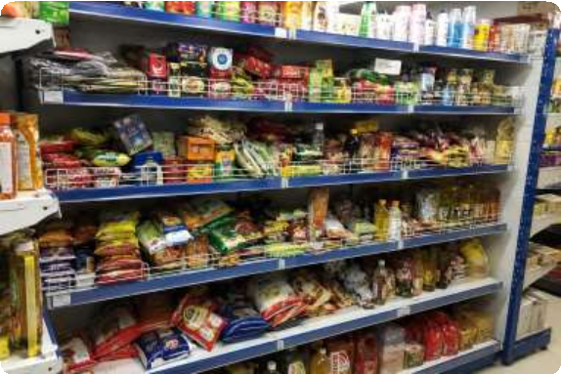
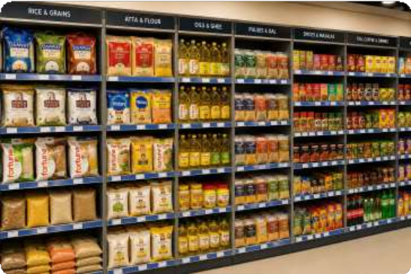

Your Store, Reimagined
From a cluttered, unorganised kirana shelf to a bright, categorized, branded Metro Super Market aisle.
BEFORE — Typical Kirana Store
AFTER — Metro Super Market
Organized Layout
Digital Billing
Bright, Branded Interiors
7

Slide 9

Building Your Store, Together
A turnkey system so you can focus on running the store, not building it from scratch.
Store Design & Layout
Brand & Signage
Space-optimized planning for maximum product density and easy
customer flow.
Consistent Metro Super Market identity — signage, visuals, and store
branding.
Billing & Inventory Tech
Ongoing Partner Support
Digital POS system for fast checkout and real-time stock tracking.
Continued guidance as you launch and grow your store.
Supply Chain Access
Onboarding to a reliable network of FMCG and grocery suppliers.

Slide 10





Smart Billing, Zero Hassle
Every Metro store runs on a fast, GST-ready digital billing system.
METRO SUPER MARKET
BILL
Barcode & Scanner Billing
Scan and bill in seconds — no manual entry, no counting errors.
Aashirvaad Atta 5kg ₹249
GST-Ready Digital Invoices
Fortune Sunflower Oil 1L ₹165
Amul Milk 1L x2 ₹112
Every bill is automatically tax-compliant and error-free.
Tata Salt 1kg ₹28
Real-Time Inventory Sync
Parle-G Biscuits x3 ₹60
Stock levels update automatically with every single sale.
TOTAL (GST incl.)
₹614
Sales Reports On Your Phone
Track daily revenue and top-selling items from anywhere.

Slide 11
Already Run a Kirana Store? Here's What Changes
The same shop, the same location — run on a stronger, more profitable system.
As an Independent Kirana
As a Metro Super Market Partner
Manual billing, prone to errors and leakage
Digital POS billing — accurate, leak-free sales
Buying at small-trader prices, low margins
Supply chain access at franchise-level pricing
Limited shelf space, limited product range
Wider, better-organized product assortment
No consistent brand identity or signage
A trusted, recognizable Metro storefront
Customers drift to organized stores nearby
Footfall and repeat visits driven by the brand

Slide 12



Who Is the Ideal Metro Partner?
Existing Kirana Store Owners
Retail Entrepreneurs
Looking to modernize and grow beyond the traditional format.
Seeking a proven, structured franchise model to launch a new venture.
Local Investors
Family Business Operators
Looking for a stable, high-footfall neighborhood business.
Wanting an easy-to-manage, structured operating system.
Anyone who wants to build a strong, organized grocery retail business.

Slide 13



Why Grocery Retail Is a Smart Bet
A category built on daily, essential, repeat demand.
Deepening Customer Loyalty
Consistent Repeat Purchase
Cycles
A Recession-Resilient Category
Groceries are a daily necessity — customers return again and again.
High-frequency buying creates predictable, recurring footfall.
Essential goods keep demand stable even in uncertain markets.
Markets reward early adopters. The future of kirana retail belongs to organized stores.

Slide 14
The Future of Kirana Retail Belongs to Organized Stores.
Metro Super Market helps you build that future today.

Slide 15



Start Your Own
Metro Super Market Today
Join the Metro Super Market Community
Apply now to bring a modern, trusted grocery format to your neighborhood.
Phone
+91-9217199793
Website
www. metroindiasupermart.com
Address
Tower Alt – f, 2nd Floor, Office no. 0209, Plot no. A 26 Block B Mohan Cooperative Near Sarita Vihar Metro Station, New Delhi - 110076
Note: replace the placeholder phone number and confirm the website URL and address before sharing.

